Slide 1
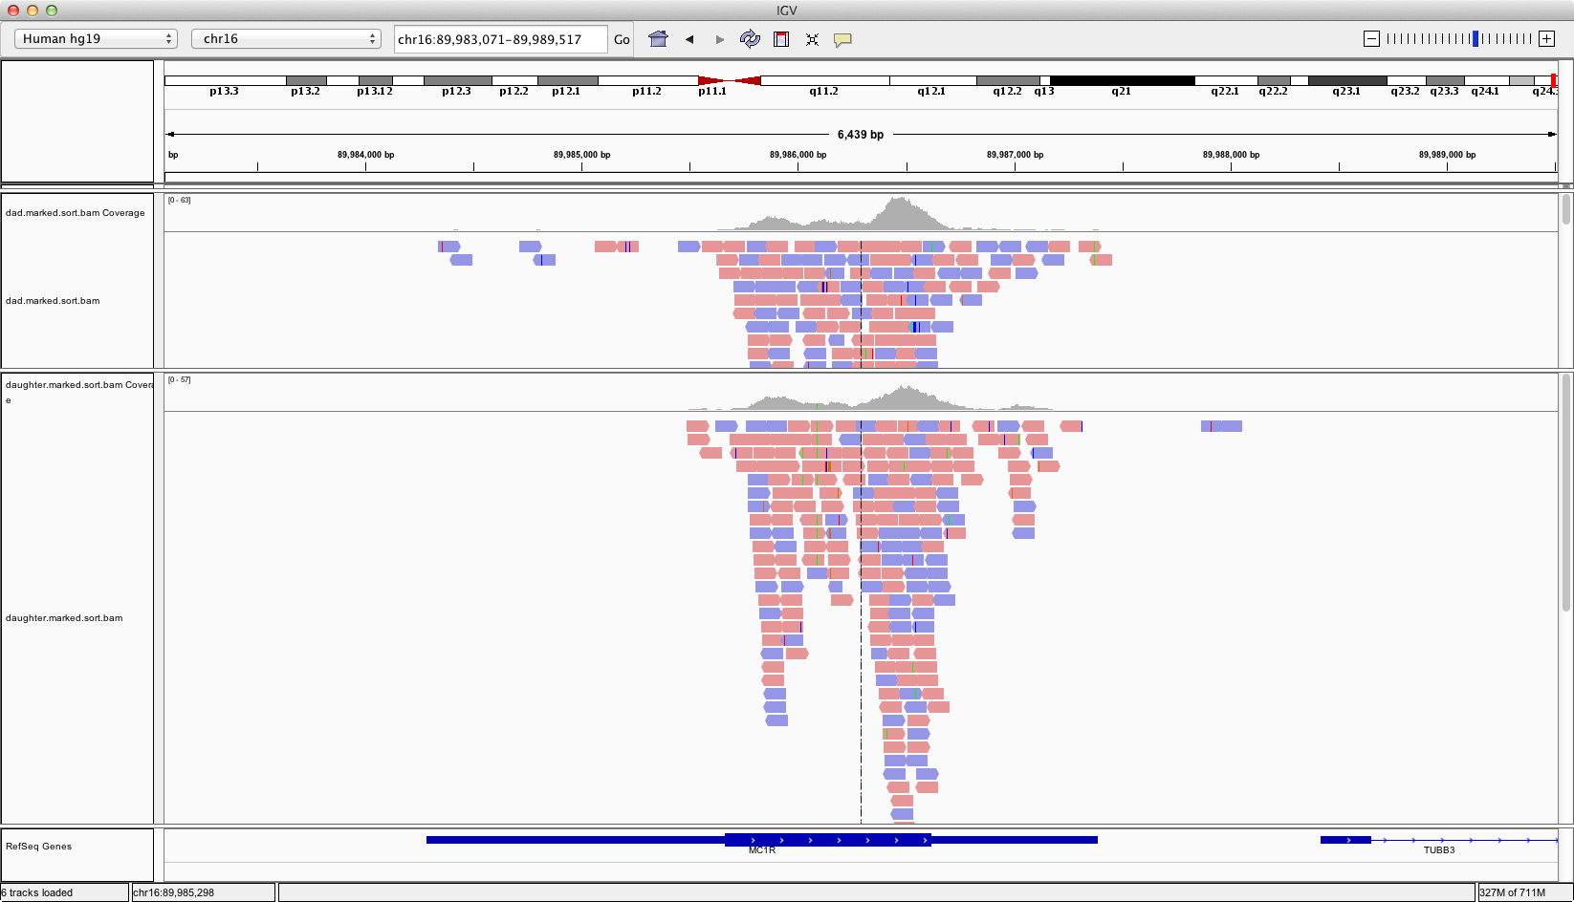
MC1R – 89,986,091
chr16 89986091 . G A 171.16 PASS AC=2;AF=0.333;AN=6;BaseQRankSum=-2.294;ClippingRankSum=0.061;DP=34;FS=3.183;MLEAC=2;MLEAF=0.333;MQ=60.00;MQ0=0;MQRankSum=-0.995;QD=10.07;ReadPosRankSum=0.101 GT:AD:GQ:PL 0/0:17,0:50:0,50,495 0/1:3,6:59:165,0,59 0/1:6,2:38:38,0,138

Slide 2
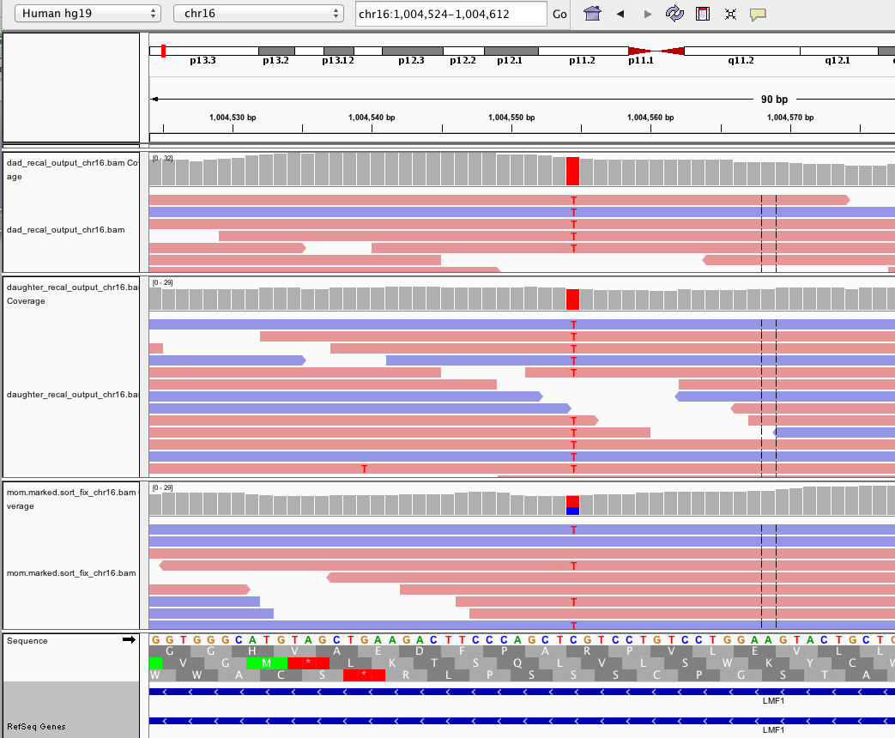
Lipase Maturation Factor

Slide 3
Manuel Corpas
https://medium.com/genomes-web-2-0-and-bioethics/my-family-exome-analysis-findings-68f8018b366b

